Slide 1
Cardonald Primary Parent Council
Open Day Session
23rd February 2023

Slide 2
What is a Parent Council?
Parents decide the priorities for the Parent Council and how it will work within the four broad areas of responsibility laid down by the Parental Involvement Act. These require each Parent Council to:
support the school in its work with pupils
represent the views of all parents
encourage links between the school, parents, pupils, pre-school groups and the wider community
report back to the Parent Forum.
Every school’s Parent Council is different because the parents in each school decide such things as:
how their Council will be set up
what it should be called
what size it should be – e.g., in a very small primary school, all parents could be involved
who should be a member of the Parent Council
how they should be appointed
what’s the most convenient time to hold meetings
what will be discussed at meetings – these might be topics such as school uniform, parking near the school, the school’s anti-bullying policy, etc.
Parent Councils can also have a role in the appointment of head teachers and depute head teachers.

Slide 3
How we work at CPPC…
We meet on the first Tuesday of every month during the school term and this is mostly on Zoom at present as we transition back to having some meetings face to face in the school.
We are very fortunate to have such great support from the vast majority of the parent forum and it is only through this support that we are able to undertake the work that we do.
We always encourage parents or carers to get involved with the Parent Council as it is your children that will benefit whilst supporting the school, staff and the local community.

Slide 4
Parent Council contributions
Below is a small sample of some of the things we help the school with;
School brushes for the playground
Fruit for the sponsored run
A freezer for the school’s first aid room
Contributions for the P7 leavers party
Books from Santa for P1-3
Money towards the class Christmas parties
Christmas Panto during lockdown
Money wallets for the schools Credit Union initiative
Storage bins for loose play storage
Football kits
P1 Parent bags on their first day of school
P1 End of year books
The PC funded the fit out of the school library
We regularly donate money to the school library for new books

Slide 5
School Football strips
As a result of vital fundraising and the money raised within the Healthy Heart Fund the PC agreed to supply the school with;
20 Full football strips
20 Full tracksuits
2 full goalkeeper strips
2 kitbags for safe storage
These have all been embroidered with the school emblem.
The strips have been greatly received by the school and the kids are enjoying having the comfort of a new kit to go to their games in!

Slide 6
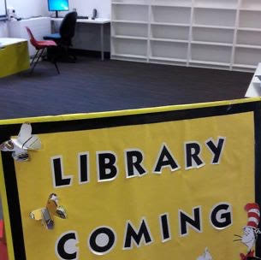
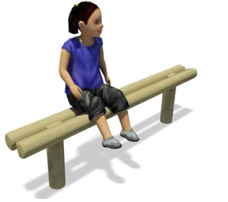
Area Partnership Funding
Over the last couple of years the PC has managed to secure funding through a local area partnership grant of over £11,000 and were able to provide a number of improvements to the playground experience for the children.
Benches 2022 -
We installed 10 benches within playground grass areas to help support outdoor learning
Library 2019
Installation of new Library
Supply of various books and novel sets for all ages.
Regular supply of updated books
Planting - 2019
Building of raised beds with Langside College.
Planting of various plants within raised beds.
Supply school with garden kits for classes to use.

Slide 7
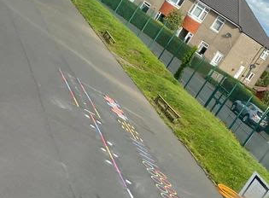
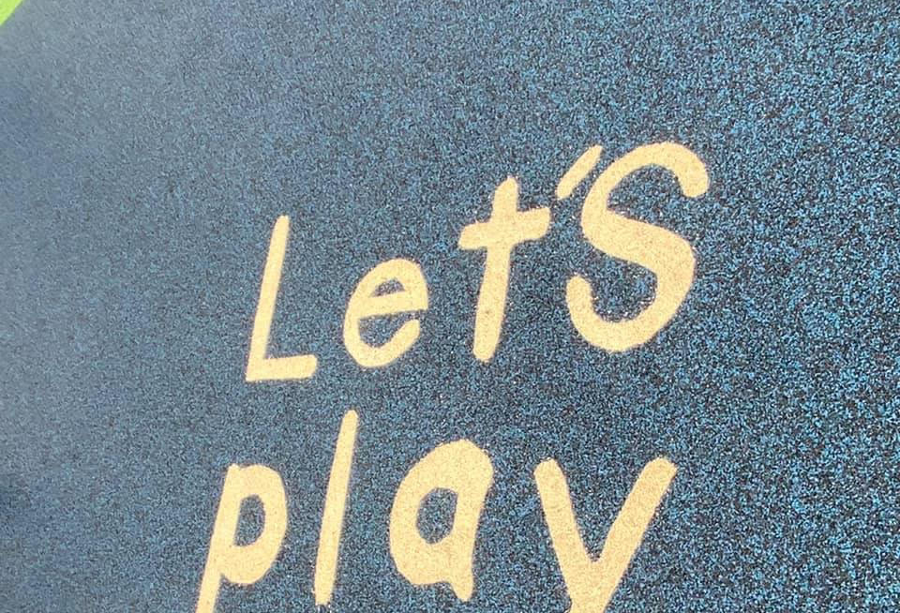
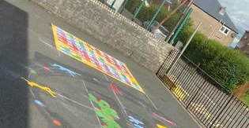
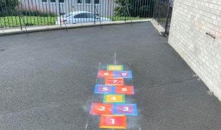
Kompan 2020 – Playground
Twist & Shout markings
Hopscotch Markings
Fun Fitness trail
Small football pitch within P1 Playground
Large Football pitch marked out in Large Playground.
Kompan 2021 – Playground
Fun Fitness Trail additional to Phase 1
170m Daily Mile Footprints around playground.
11m x 11m Roadway with traffic signage
Stop, Look & Listen at all exit gates.
Marked Lines around the basketball hoops.

Slide 8
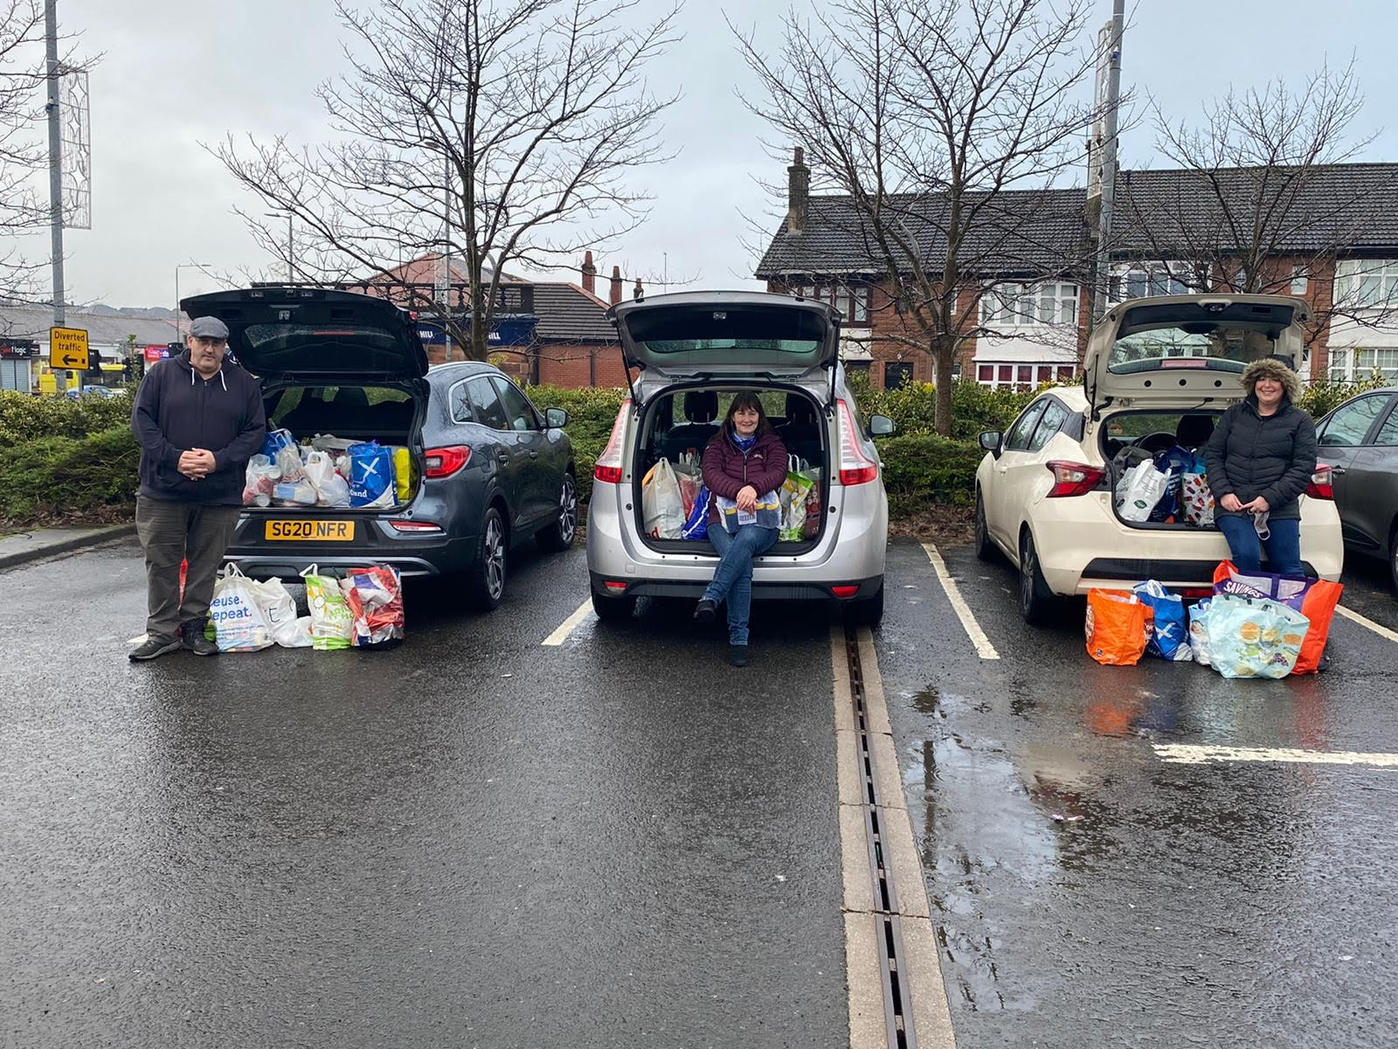
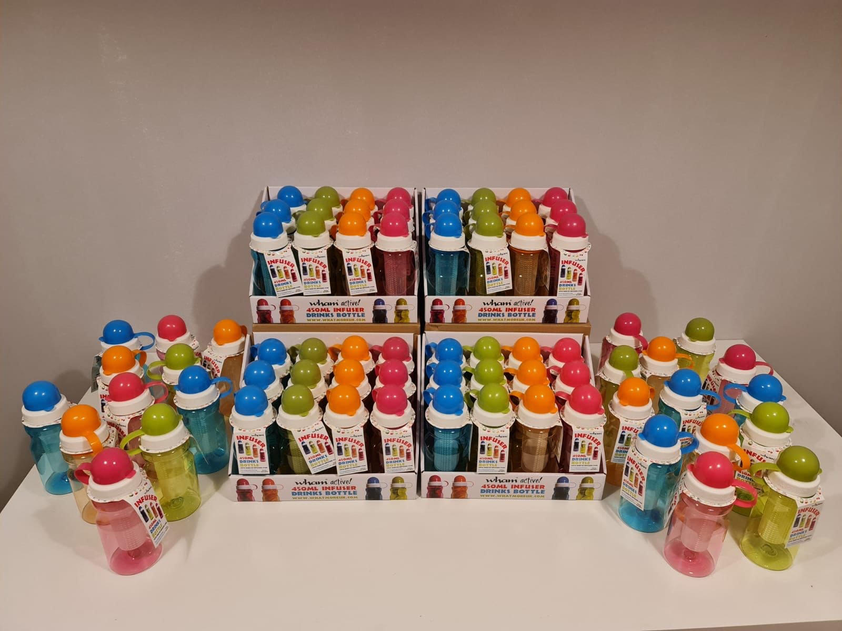
The parent council supplied the school with a number of water bottles for the children and have also regularly arranged collections through the school for the local foodbank.

Slide 9
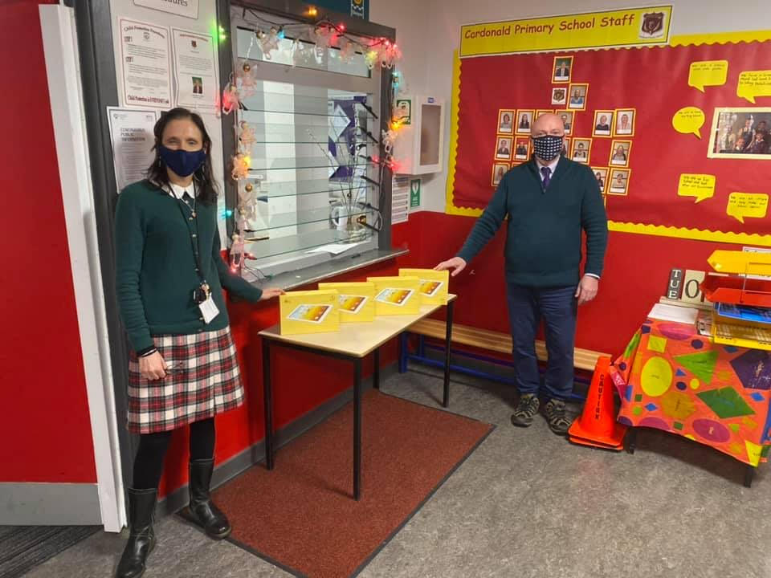
Virgin Money funding
The parent council also secured funding from Virgin Money to purchase 4 tablets for the school and paid for internet access for families that needed it during lockdown to allow children to do their home learning.

Slide 10
Get your dancing shoes on..
Due to covid restrictions over the last couple of years we were unable to have any school disco’s. We were delighted to be able to reintroduce this in December and had 2 very successful Christmas Discos for P1-3 and P4-7.
Plans are underway to arrange another disco in the spring…..watch this space!

Slide 11
Bonus Ball
The bonus ball is a vital part of fundraising for our school and every penny counts, whether it’s for new books in the school library, playground equipment or some extras at the Christmas disco, the money is really important. It’s super easy to get involved. The number is based on the bonus ball in the National Lottery Saturday night draw and if you win you get £25 with the remainder going into the fundraising pot.
It’s £1 per number per week and so that we remain cashless we ask that you set up a standing order either weekly or every 4 weeks so that payments are made in full ahead of the Saturday draw. If you want to get involved and support the school please email treasurer.cardonaldpc@gmail.com and we will be happy to let you know the available numbers and provide further information.

Slide 12
If you would like to get involved with the Parent Council please contact us using our email address below;
info.cardonaldpc@gmail.com

